Slide 1
Handout # 5: Midterm Exam Review
CSC 358 – Principles of Computer Networks

Slide 2
Layering
“Layering” is commonly used in computer networks, because:
It forces all network software to be written in ANSI ‘C’.
Encapsulation is the lowest overhead method to transmit data. T
It allows widespread code and implementation re-use.
It keeps networks warm enabling them to run faster.
Notes:
C

Slide 3
Longest Prefix Match
Which of the following are true?
171.64.128/17 cannot be a prefix because it is a Class B address.
If a routing table contains prefixes 31.75/16 (for which packets are sent to port 1) and 31.75.93.128/25 (for which packets are sent to port 2) then an arriving packet with IP address 31.75.93.129 will be sent to port 2.
A routing table can correctly contain the two prefixes 50.50.128/17 and 50.50.128/18 simultaneously.
If a routing table is organized in order of decreasing prefix length, then a routing decision may be performed by finding the first matching prefix.
Notes:
B, C, D

Slide 4
Transmission Rate
What transmission rate is needed to transmit a 4" x 6" photograph (uncompressed, and with a resolution of 1200 dots per inch and 24 bits per pixel) in 1 second?
691,200kb/s
28.8kb/s
28.8kbits
8.29Mb/s
None of the above.
Notes:
E: 829.44 Mbps

Slide 5
IP Addresses
What is the dotted decimal notation whose hexadecimal representation is CC15641E?
205.11.99.44
204.21.100.30 T
192.168.10.1
172.44.59.10
Notes:
B

Slide 6
Broadcast Address
Which destination address do we send the ARP request if we do not know the MAC address of a host? [1/1]
40:8E:A2:32:F9:80
00:00:00:00:00:00
FF:FF:FF:FF:FF:FE
FF:FF:FF:FF:FF:FF T
Notes:
D

Slide 7
Ethernet
Which of the following statements are TRUE? [1/1]
The Ethernet is a connectionless and reliable data link protocol
Ethernet switches, like IP routers, use a table to determine which output links to send a packet. T
Ethernet switches will always send received frames out on all interfaces (except the one on which the packet was received).
The Maximum Transmission Unit (MTU) of Ethernet is dictated by the buffer size of the link-layer endpoints.
Notes:
B

Slide 8
MAC Address
Which statement(s) are true regarding MAC and IPv4 addresses.
IP addresses may be assigned dynamically; MAC addresses are burned into the network device. T
MAC addresses are hierarchical, whereas IP addresses are flat.
MAC addresses are 48-bits long, whereas IPv4 addresses are 32-bits long.
MAC and IP addresses are Layer-3 addresses
Notes:
A & C

Slide 9
CIDR
A network advertises the CIDR network number 50.1.59/25 (and no other numbers). Which IP addresses could the network own?
50.1.59.100 T
50.1.60.44
50.1.59.144 T
50.1.61.44
Notes:
A & C

Slide 10
Router
Which of the following header fields will be modified by an IP router during packet forwarding?
Source IP address
Source MAC address T
Ethernet header checksum
IP header checksum T
Destination IP Address
Destination MAC Address T
Notes:
B, C, & F

Slide 11
Latency
A message of size 100,000 bytes is sent from a source node A to a destination node B passing through two routers R1 and R2. All three links on the path have a delay of 20 ms. Node A has a transmission rate of 1000 bits/sec, R1 has a transmission rate of 1000,000 bits/sec, and R2 has a transmission rate of 10,000 bits/ sec. Assuming this is a store and forward system, and there is not queueing delay, find the end-to-end latency of the message in each of the following cases. Ignore any header overheads.
We send it as a whole.
We break the message into 100 packets each of size 1000 bytes.

Slide 12
Latency
A -> R1 ->R2 -> B
end-to-end latency = d_{transmission_A} + d_{propagation_1} + d_{transmission_R1} + d_{propagation_2} + d_{transmission_R2} + d_{propagation_3} = (100,000 * 8) / 1000 + 0.02 + (100,000 * 8) / 1000,000 + 0.02 + (100,000 * 8) / 10,000 + 0.02 = 880.86 sec
end-to-end latency for the first packet = (1000 * 8) / 1000 + 0.02 + (1000 * 8) / 1000,000 + 0.02 + (1000 * 8) / 10,000 + 0.02 = 8.868 sec
Our bottleneck is A; hence, after the arrival of the first packet, we have a packet every 1000 * 8 / 1000(bit/s) = 8 sec (we are sending the packets back to back at the source). Total latency = 8.868 + 99 * 8 = 800.868 sec.

Slide 13
Encoding
Represent the bit sequence 1011 1010 1100 0111 1010 1010 in NRZ, NRZI, and Manchester encodings.

Slide 14
Fragmentation
A TCP message of size 3000 (including the TCP header) bytes is sent over a series of three IP routers. The MTU for the routers (in the order that the message passes through them) are 1500 bytes, 800 bytes, and 1000 bytes. Assume IP header is 20 bytes, link layer headers are 30 bytes, and packets are not reordered in this system. Show the sequence of packets as they arrive to the destination node. For each packet identify the packet length, as well as the offset.
B

Slide 15
Fragmentation...

Slide 16
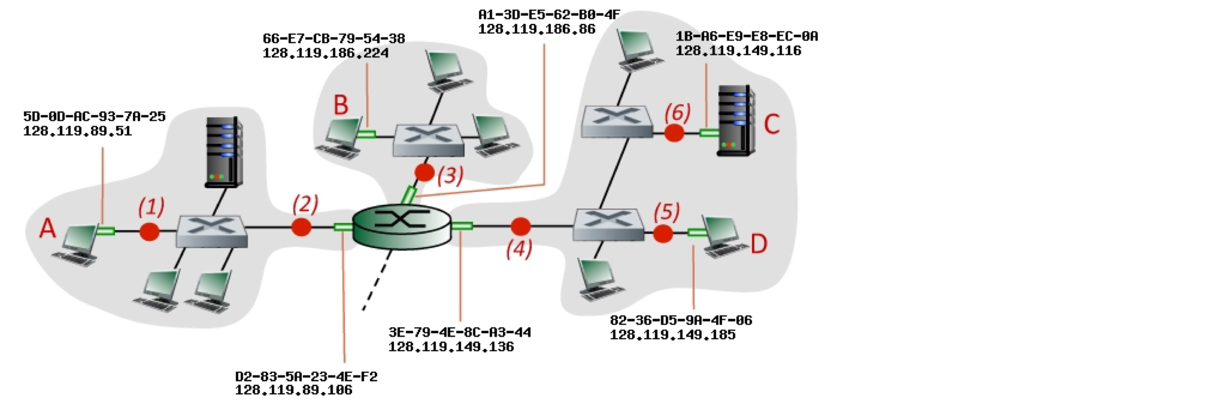
Source & Destination

Slide 17
Source & Destination
Consider an IP datagram being sent from node A to node C. Give the source and destination Ethernet addresses, as well as the source and destination addresses of the IP datagram encapsulated within the Ethernet frame at points (1), (4), and (5) in the figure above.
Repeater, hub

Slide 18
Source & Destination
Point | Source IP | Destination IP | Source MAC | Destination MAC
(3) | 128.119.186.224 | 128.119.149.185 | 66-E7-CB-79-54-38 | A1-3D-E5-62-B0-4F
(4) | 128.119.186.224 | 128.119.149.185 | 3E-79-4E-8C-A3-44 | 82-36-D5-9A-4F-06
(5) | Same as (4)

Slide 19
Protocols
You’ve learned about multiple communication protocols across the different network “layers”. List one or more protocols for each layer:
Application -- Give 2 examples:
Transport -- Give 2 examples:
Network -- Give 1 example:
Link -- Give 2 examples:
Notes:
a.) HTTP, SMTP, NFS
b.) TCP, UDP
c.) IPv4
d.) Ethernet, WiFi (802.11), SONET

